Slide 1
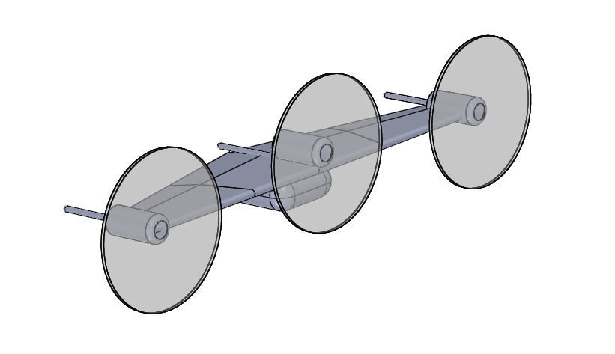
Landing attachments
Propulsors

